Slide 1
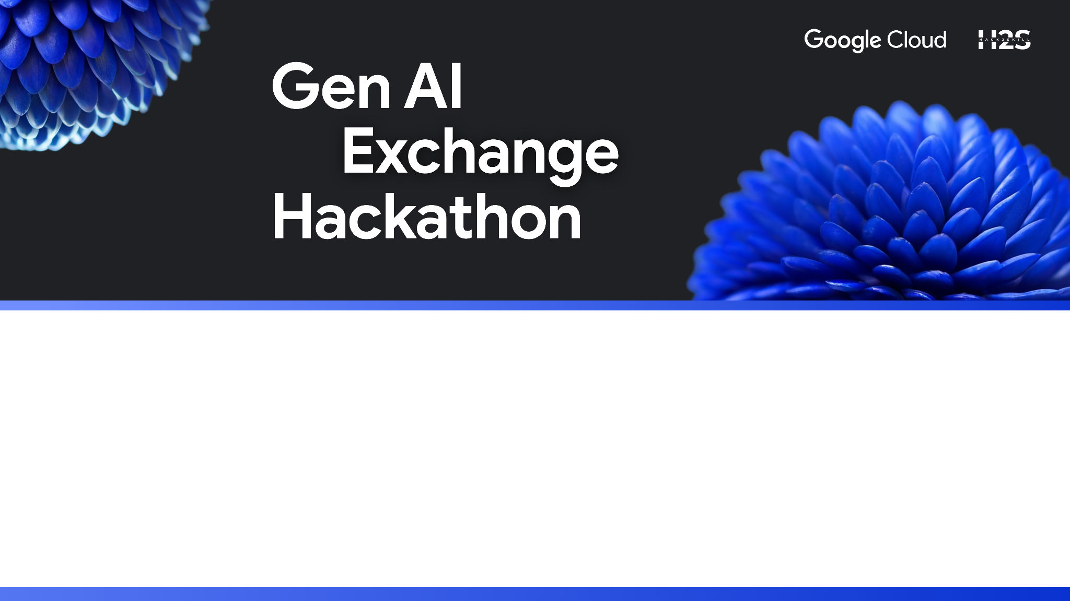
Team Name : Kanyarasiiii
Team Leader Name : MANIGANDLA SURYA CHARAN
Problem Statement : Generative AI for Youth Mental Wellness

Slide 2

Brief about the prototype :
MindfulSpace is a comprehensive youth mental health awareness platform specifically designed for young people aged 13-25. This full-stack web application combines cutting-edge AI technology with empathetic design to create a supportive digital environment for mental health support.
Key Features:
• AI-Powered Chat System - Integrated Google Gemini Pro API with youth-specialized prompts for personalized mental health support
• Smart Rate Limiting - Intelligent usage tracking (50 requests/hour) with visual indicators and graceful fallback systems
• Youth-Focused Design - Modern, accessible interface with dark/light themes and advanced CSS animations
• Mood Tracking & Analytics - Local storage-based mood tracking with trend analysis and visual statistics
• Wellness Activities - Interactive breathing exercises and mindfulness tools for stress management
• Mental Health Resources - Curated library of crisis support and educational content for young people.
Technical Implementation:
• Frontend: React 18 with responsive design, PWA support, and advanced UI components
• Backend: Express.js REST API with file-based JSON storage and comprehensive middleware
• AI Integration: Multi-tier response system (Gemini Pro → Server → Local fallbacks)
• Specialized Intelligence: Recognizes academic stress, social anxiety, family conflicts, and identity concerns
Impact & Innovation:
• Addresses critical gap in youth mental health technology
• Promotes mental health awareness and reduces stigma
• Provides 24/7 accessible support with age-appropriate language
• Combines professional AI capabilities with peer-relatable communication

Slide 3
🔍 How different from existing solutions?
• Youth-Specialized AI - First platform with AI trained specifically for 13-25 age group mental health • Smart Fallback System - Multi-tier responses (Gemini Pro → Server → Local) ensuring 24/7 availability • Transparent Rate Management - Educational approach to API usage with visual tracking • Accessibility-First Design - Dark/light themes, mobile-responsive, reduced motion support
🎯 How will it solve the problem?
• Immediate Access - No appointments, waiting lists, or barriers to entry
• Age-Appropriate Language - Understands academic stress, peer pressure, identity struggles
• Stigma-Free Environment - Private, anonymous support that normalizes mental health conversations • Comprehensive Support - AI chat + mood tracking + wellness tools + crisis resources in one platform
⭐ Unique Selling Proposition (USP)
• Youth Mental Health Specialization - Only platform designed specifically for young people's mental health needs
• Sustainable AI Architecture - Smart resource management with educational component about digital wellness
• Empathetic Technology - Combines cutting-edge AI with human-centered emotional safety design • Community Impact - Promotes mental health literacy and creates a generation comfortable seeking support

Slide 4
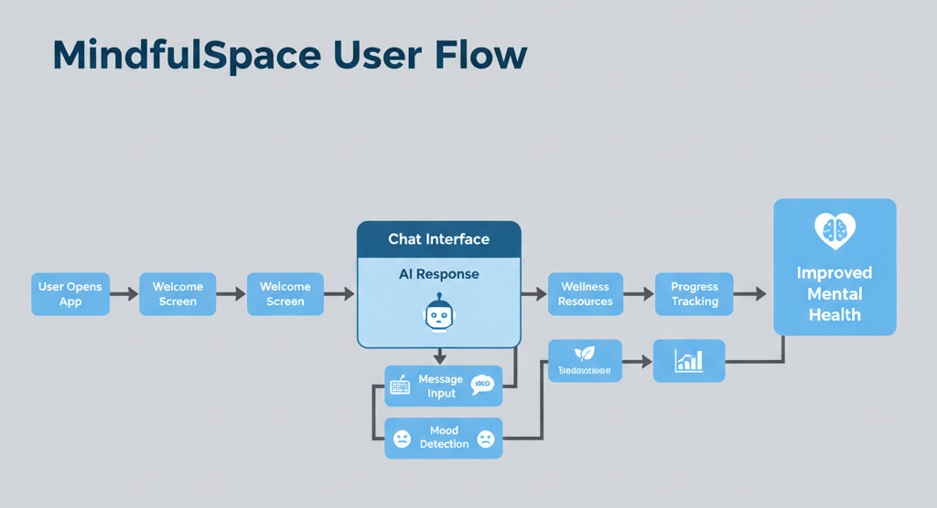
List of features

Slide 5
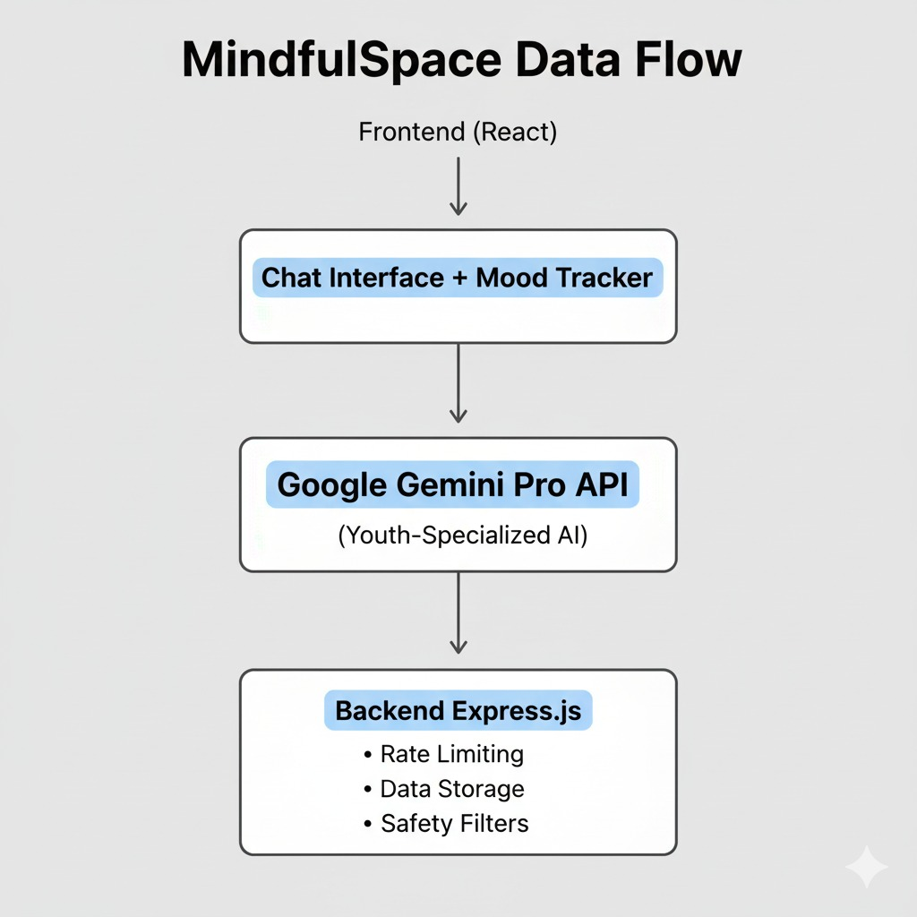
List of features

Slide 6
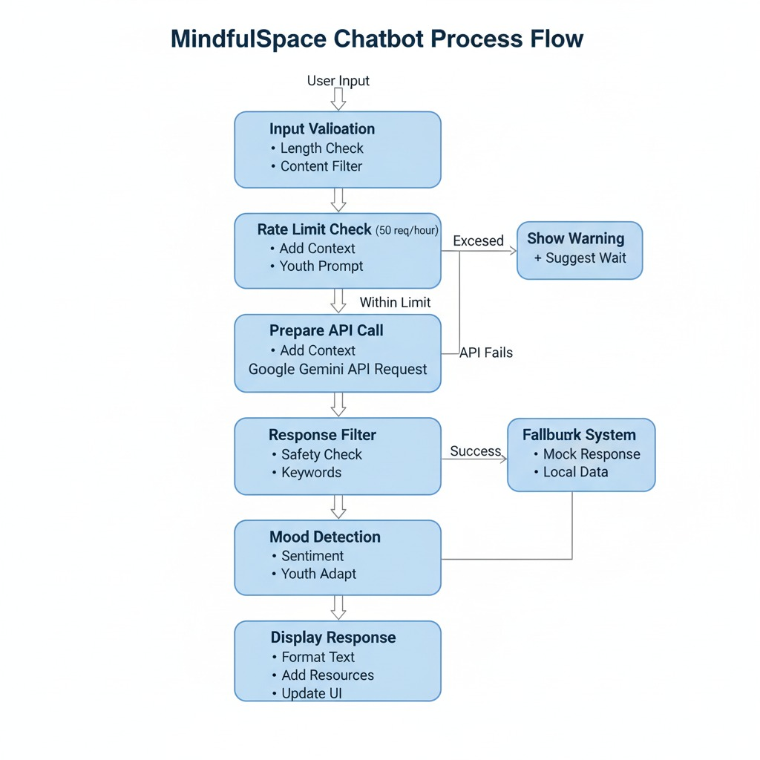
List of features

Slide 7
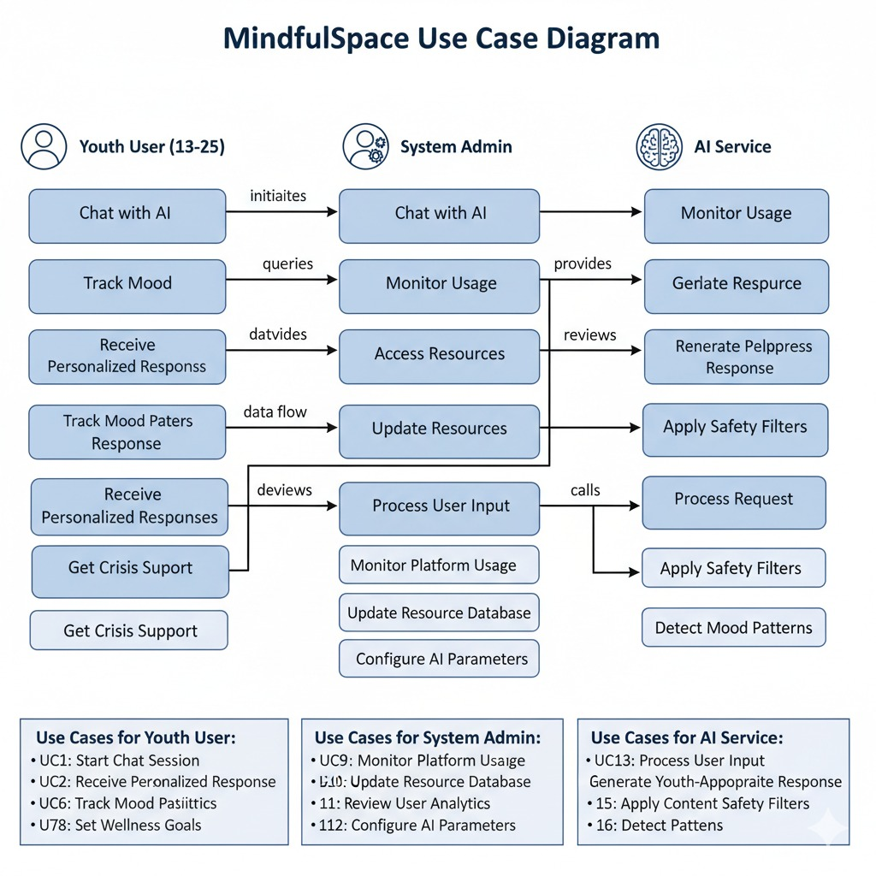
Use-case diagram

Slide 8
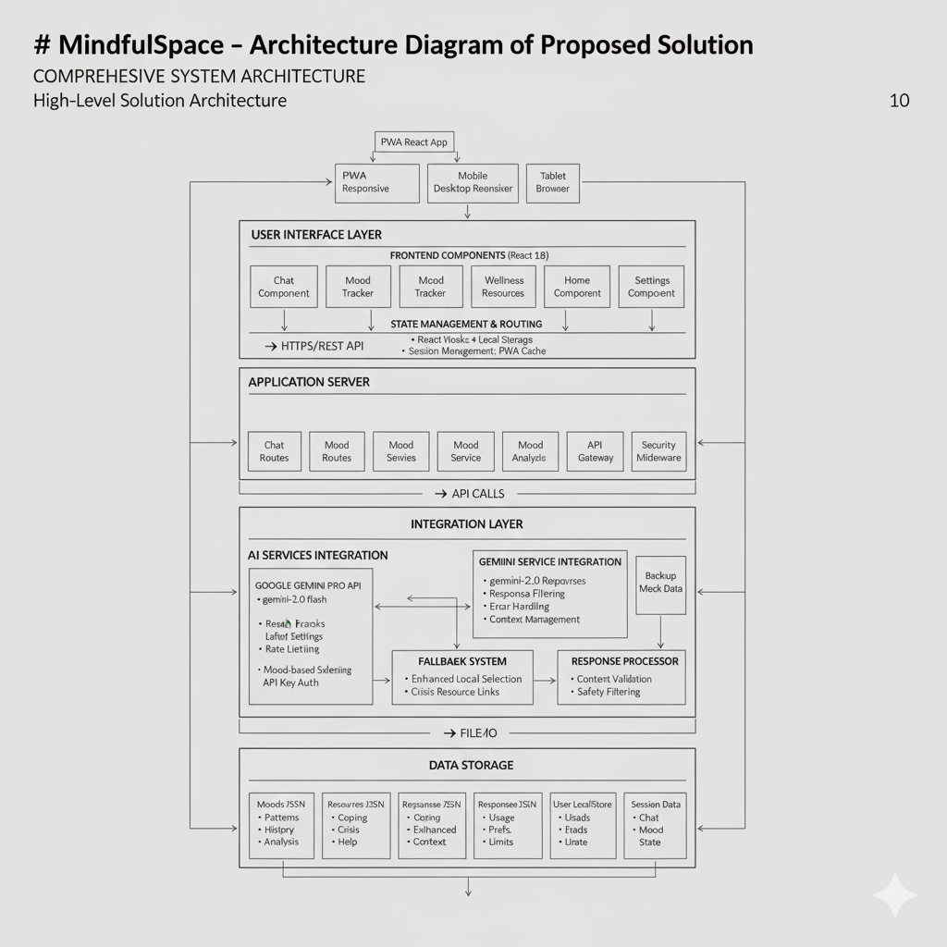
Architecture diagram

Slide 9
Technologies to be used in the solution:
✅ Modern Tech Stack - React 18, Node.js, Express.js ✅ AI Integration - Google Gemini Pro with custom youth prompts ✅ Security Focus - Multi-layer protection and rate limiting ✅ Mobile-First - PWA with offline capabilities ✅ Scalable Architecture - Cloud deployment ready ✅ Privacy-Focused - Local storage, no data tracking ✅ Youth-Specialized - Age-appropriate AI filtering
Future Technology Roadmap:
Shows planning for scalability:
Phase 2: Database migration, Redis caching, WebSocket
Phase 3: Custom ML models, voice integration, native apps

Slide 10


